Slide 1
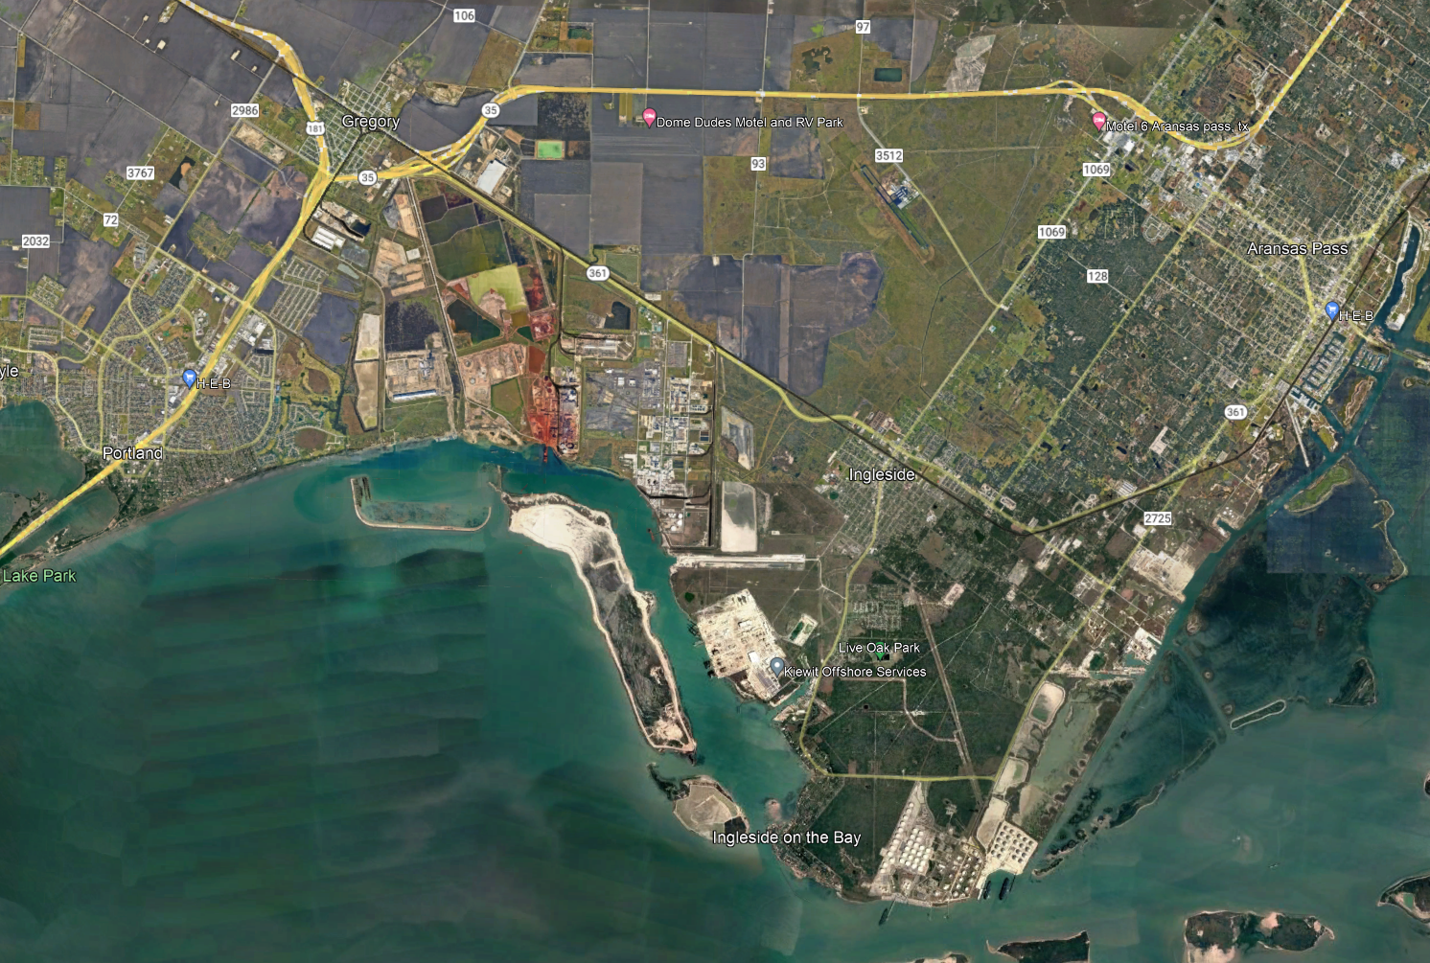
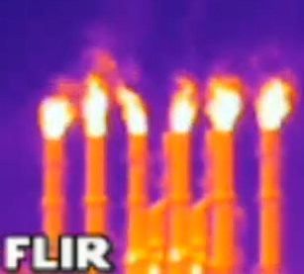
EXXON SABIC
ENBRIDGE WATER USE PERMIT RISKS
EFUELS
KISUMA
TPCO ($3M)
BLUE BAY
POCC AMMONIA
VOESTALPINE ($-88M)
CHENIERE WR Permit
POCC WR 101,334acft
OXY/CHEMOURS
WATER RIGHTS PERMIT
POCC AMMONIA
PROPOSED AMMONIA SITES
SCHOOLS
SCI AIR MONITORS
ENBRIDGE/YARA AMMONIA
CARBON CAPTURE STORAGE SITE
GIBSON
Patrick Nye - Ingleside on the Bay Coastal Watch Association
ENBRIDGE WR 500acft
Notes:
Cyndi – IOBCWA was formed for charitable, educational and scientific purposes. Our mission today is to inform residents of the threats from the proposed blue hydrogen and ammonia facility.

Slide 2
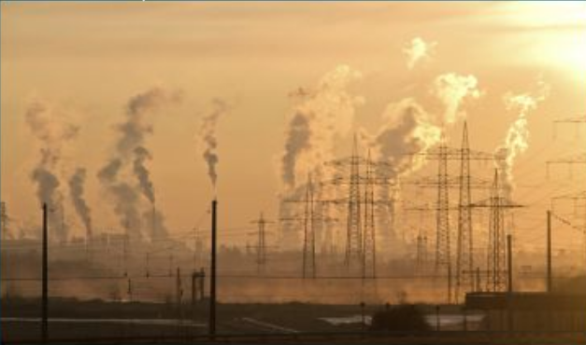
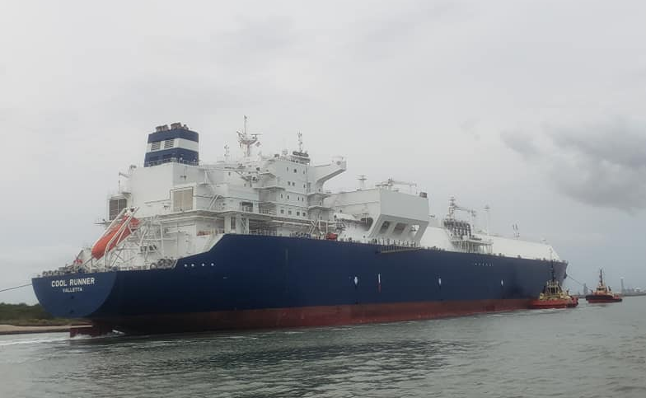
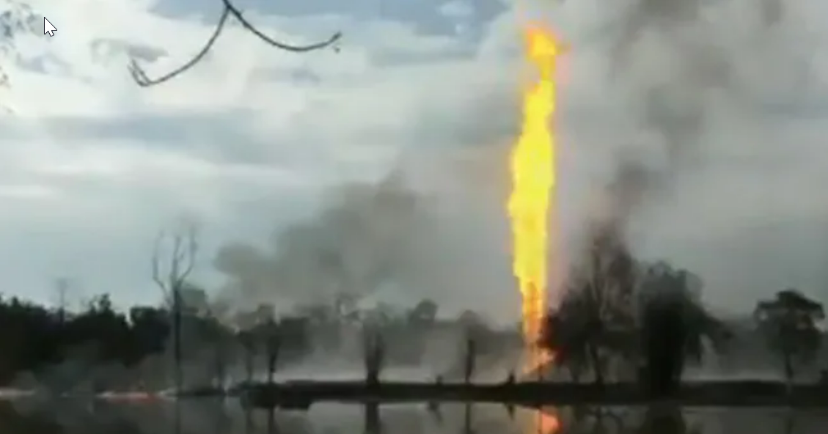
Coastal Bend Challenges
Health impacts faced by citizens
Industry Influence in Policy and Politics
Severe Environmental Degradation
Breathing problems, & increased cancer danger & anxiety from increased industry expansion
Port of CC and industry giants influence state & local politics. TCEQ bows to legislative pressure
Desalination threatens to destroy CC Bay. Shipping traffic & dredging destroying seagrass beds. Threat of oil spills, vessel collisions always present
Notes:
Corpus Christi leads the state in cancer rates. A recent health report published by the Nueces County Health Department reported that the average life span of a person living in Hillcrest, a historical black, environmental justice community at the edges of what is locally known as refinery road, is only 70 years old. Only 10 miles across town, in the more affluent area of town, the life expectancy if 85 years. 15 years life expectancy based on your zip code.
Hard to combat the false narratives of the petrochemical industry. Take Carbon Capture and Sequestration.
Scientific seagrass studies conducted in Ingleside on the Bay shows how the silt kicked up from the large crude carries and tug boats in the span of only a couple of years have decimated acres of seagrass. At this same facility a runaway barge crashed into the dock of the Crude Export facility destroying 240 of the pier. A totally full tanker had departed from the dock only minutes before.

Slide 3
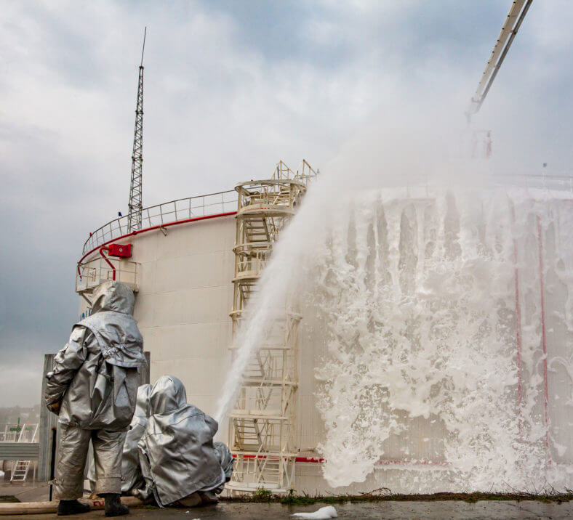
WATER RIGHTS PERMIT WR13775
Enbridge states the water permit is for 500acft of water per year to be used as “fire water”.
500acft of water = 162,925,714 gallons annually, 446,371 gallons per day
Additionally, they applied for100,000 gal./minute!!! =6,000,000 gal./hour!!!! That’s a lot of water!!!!
Oil and Gas fires can be put out with a combination of water and foam.
Reason why salt water would not be used for fire water? = Corrosion
What they could possibly be using this much volume for?
Where does Enbridge/Yara intend to get their water for ammonia facility?
Notes:
Cyndi- Fire water for oil and gas is put out using a combination of water and AFFF foam. Flint Hills advised they tore down one water tank because they only need one. They test 30 minutes every 2 weeks and 1 hour a month. Flint Hills recycles their water and worry about moving to seawater and the effects the salt would have on the integrity of the fire fighting equipment.

Slide 4
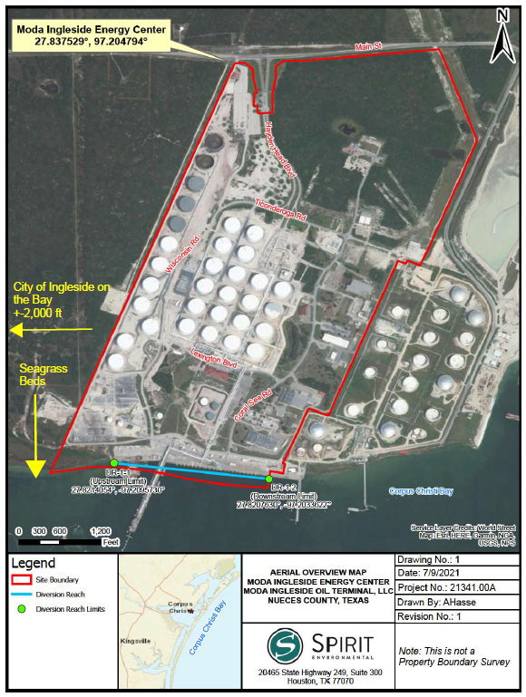
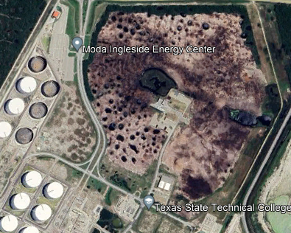
2.8 Million Metric Tons per Year of Ammonia Production
Enbridge/Yara has never told the public WHERE this water is coming from nor HOW MUCH WATER NEEDED.
ENBRIDGE/YARA AMMONIA FACILITY CLEARING UNDERWAY
July 2021
There are currently three (3) proposed mobile pump systems to be located along this
diversion reach. However, Moda may add additional pump systems to be placed anywhere along
the proposed diversion reach as needed for future expansion. The three (3) proposed mobile
pump systems, and any additional pump systems constructed in the future, will divert water at a
combined maximum flow rate not to exceed 100,000gpm.
WATER RIGHTS ARE IN PERPETUITY & CAN BE SOLD OR TRANSFERED BY APPLICANT

Slide 5
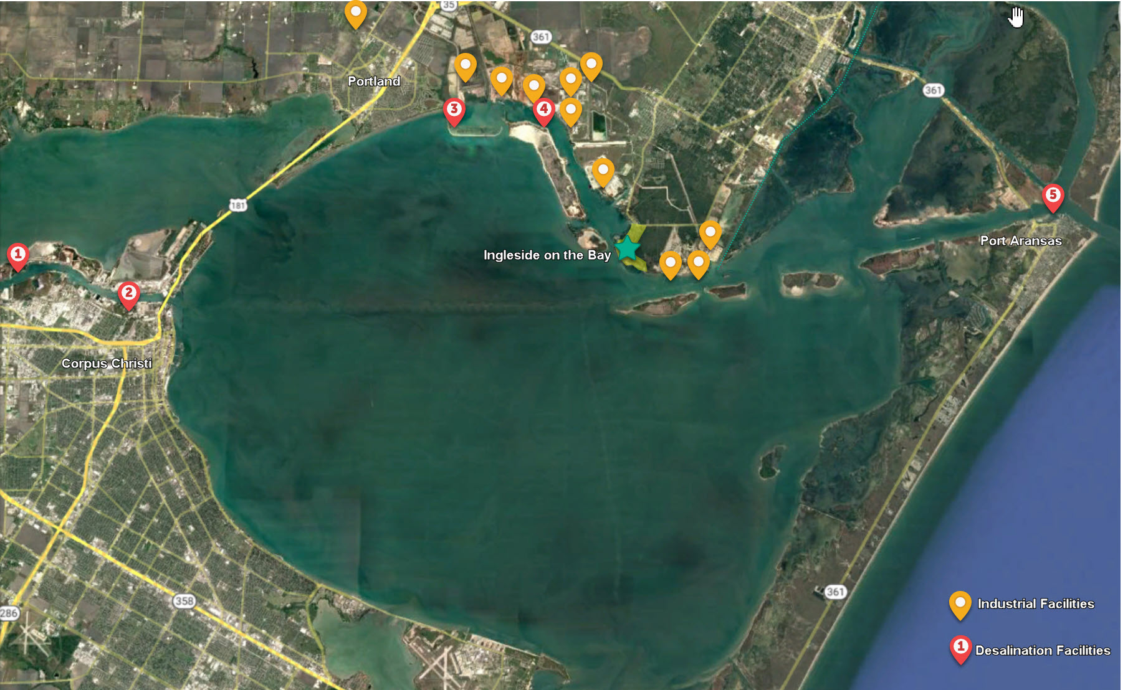
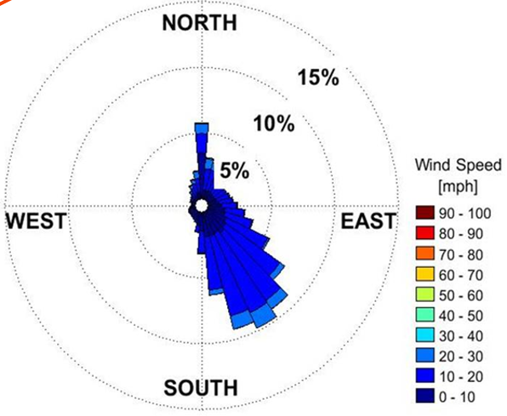
WHERE WILL MILLIONS OF GALLONS OF FIRE WATER GO?
Direct Effects
Direct Effects
How can Enbridge justify 100,000 gallons per minute 476,371 gallons per day for fire water?
When huge volumes of ”emergency” “fire water” is used, what are the wastewater & oil spill environmental protection requirements?
NUECES BAY
Impingement & entrainment of aquatic species by intake. CC Bay takes 50-months for circulation of Nueces Bay freshwater.
ENBRIDGE
Emissions from the toxic VOCs & carcinogens in foam will flow downwind towards schools and communities.
GULF WATERS FLOW INTO BAY DUE TO EVAPORATION
CORPUS CHRISTI BAY
Where does spent fire water consisting of saltwater, oil and foam go? Flint Hills oil spill circulated in CC Bay and caused huge negatively impacts on water quality.
Live Oak Peninsula consists of permeable sand recognized as ancestral Padre Island. Considering the large volume of bay water proposed, will Live Oak trees & water wells be affected? What about freshwater seeps at base of dunes?
CC BAY CIRCULATION
ENBRIDGE WR PERMIT
WIND ROSE
ADDITIONAL ISSUES WITH WR PERMIT
Upstream & Downstream locations are the opposite of predominate water flow. Downstream is towards Ingleside on the Bay, TX.
Upstream & Downstream locations are too close (~100) to seagrasses.
Are Screen size & velocity at the intakes calculate not to cause impingement and entrainment of marine organisms?
Permit allows for additional pump systems for “Future Expansion”. NO Guarantee this WR will not be modified for Ammonia.
2.8mmty Ammonia requires ~1.2 billion gallons water per year. Using 100,000gpm with distillation processes yields ample water for ammonia production.
Request for TCEQ to study risks to such huge volumes of bay water to marine life, vegetation & nearby communities
Notes:
PATRICK:
Map of the Five proposed desalination plants within Corpus Christi Bay. The Yellow markers are the current industrial developments in San Patricio County. These include the largest Ethane Cracker plant in the world owned by the Exxon Sabic, Enbridge_the largest crude oil terminal in North America and Cheniere_the biggest US exporter of Liquified Natural Gas.
*Click* In addition to impingement and entrainment of aquatic species due to intake, massive brine discharge into the low-flow, CC Bay estuary will negatively impact water quality.
*Click* Additional energy required to desalinate highly turbid water on the Corpus Christi and La Quinta Ship Channels will further strain the Texas power grid.
*Click* If the cost to build desalination plants is born by the taxpayer, and the water is used for industry, will the industry be required to repay the public for the construction of the plants and pipelines? [I would change this to be: Why are public funds being used to build desalination plants when only private industries benefit?
*Click* If even one (1) of the four (4) proposed Corpus Christi Bay desalination plants is built, many more harmful industries will locate in San Patricio County. Many are already being recruited by POCC and CCREDC.
*Click* Additional petrochemical industries will worsen air quality and jeopardize our air attainment status. The region’s being in “air attainment” is one of the major draws for attracting more petrochemicals to come here.

Slide 6
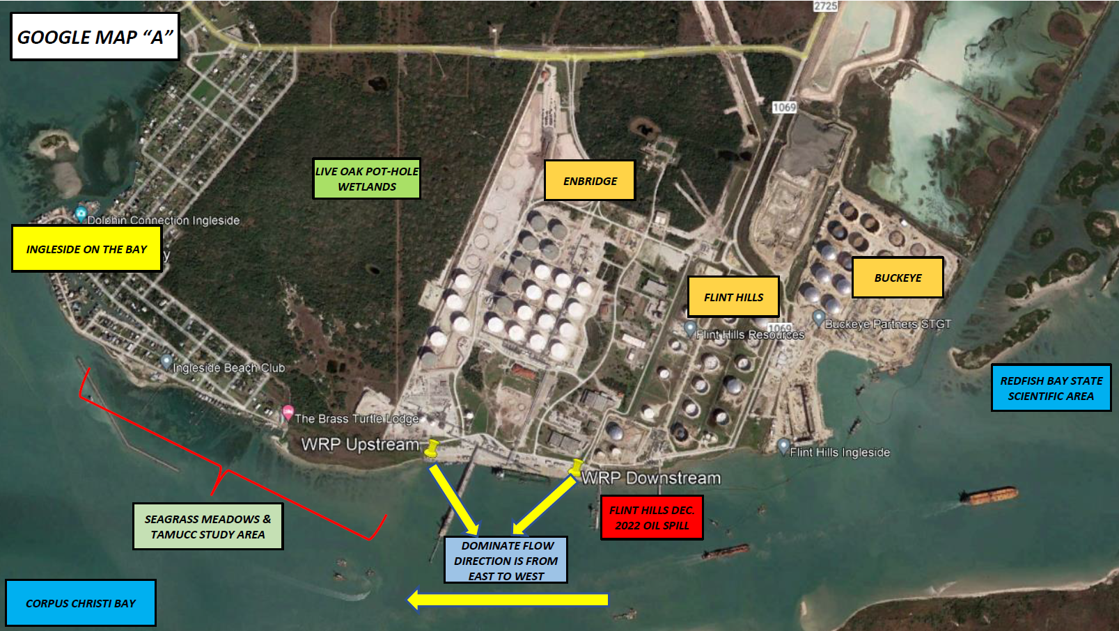
ENBRIDGE/YARA AMMONIA FACILITY
KARANKAWA ARTIFACTS
FLINT HILLS JAN. 2024 OIL SPILL

Slide 7
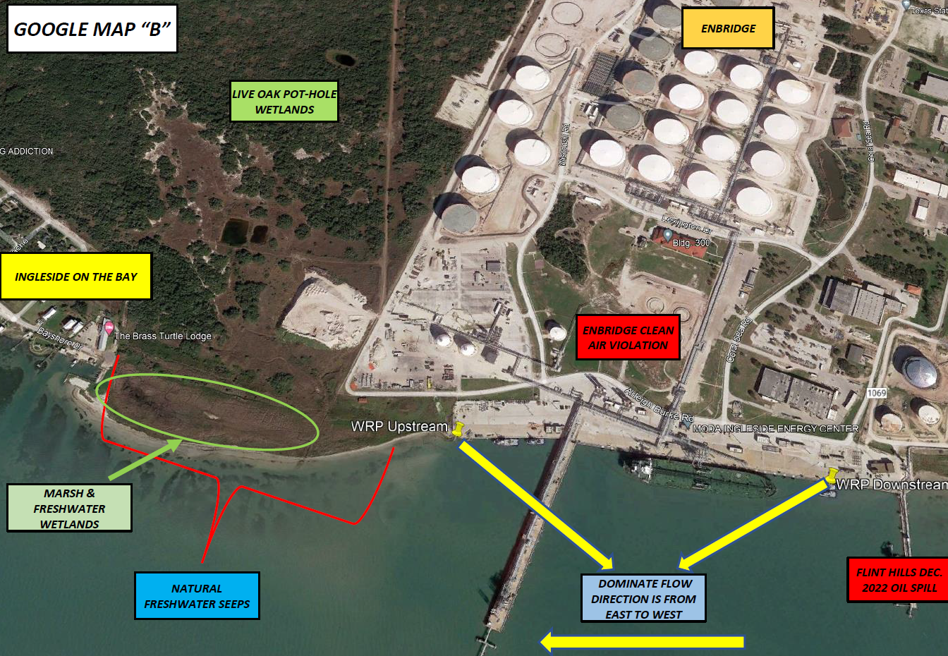
KARANKAWA ARTIFACTS
ENBRIDGE OUP VIOLATION 5/2023
ENBRIDGE CLEAN AIR VIOLATION 1/2023
FLINT HILLS JAN. 2024 OIL SPILL
ENBRIDGE CLEAN WATER ACT VIOLATIONS 2020-2024

Slide 8
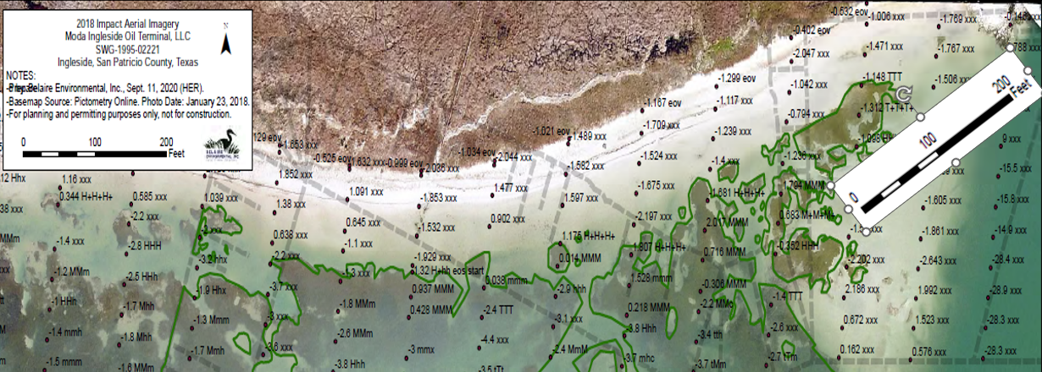
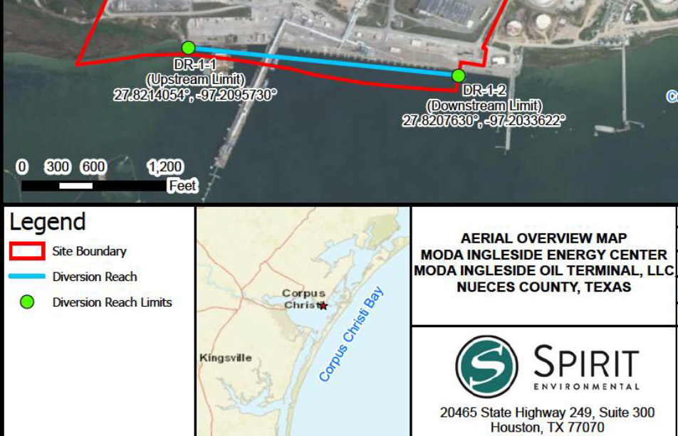
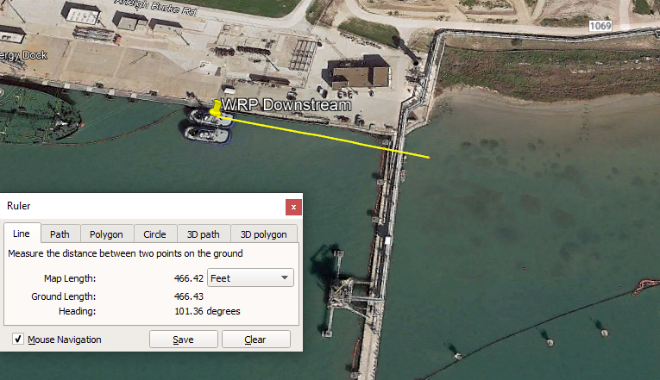
DIVERSION POINT REACH
Mobile Pumps Along Reach at 100,000gpm
This is Too Close to Seagrasses
SEAGRASSES ~100’ FROM UPSTREAM LIMIT
CORPUS CHRISTI BAY FLOW DIRECTION IS EAST TO WEST
SEAGRASSES ~466’ FROM DOWNSTEAM LIMIT

Slide 9
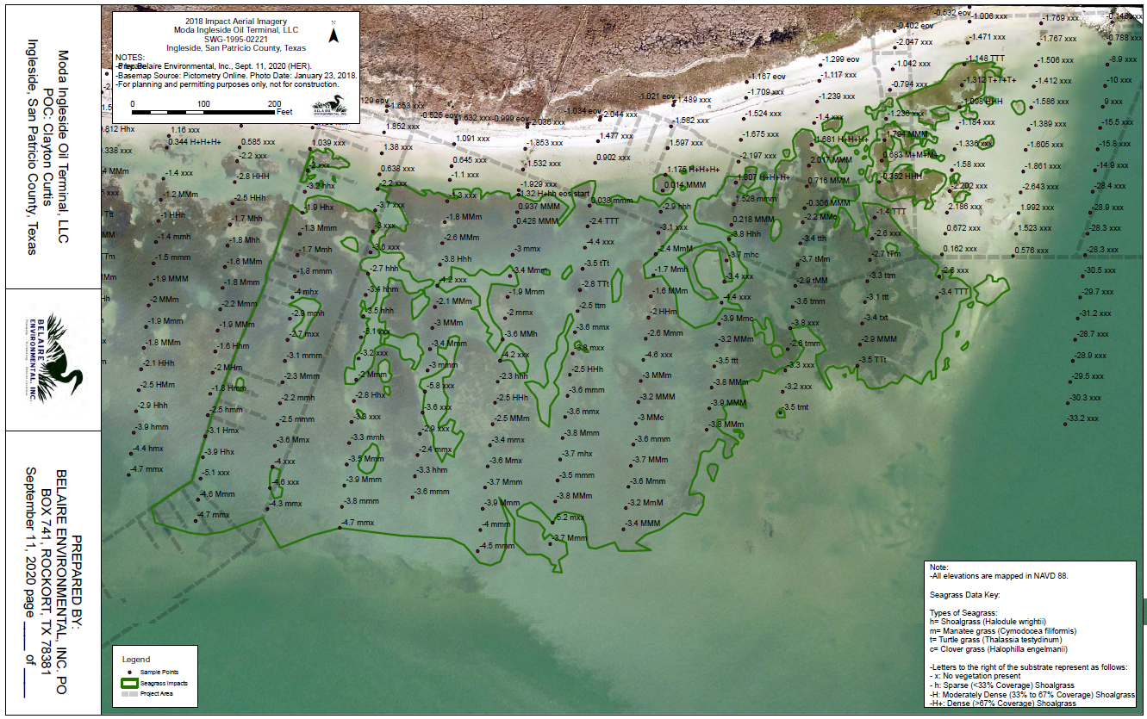
SEAGRASS STUDY
Belaire Environmental for Enbridge
SEPTEMBER 11, 2020
UPSTREAM DIVERSION
REFERENCE POINTS
Notes:
MODA NOW ENBRIDGE CORE SAMPLED SEAGRASSES FINALIZED SEPTEMBER 11, 2020.

Slide 10
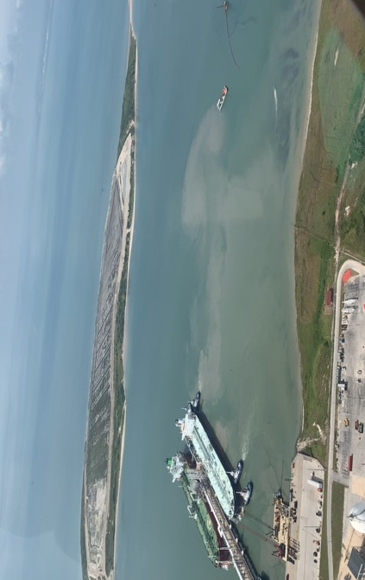
SEAGRASS STUDY
Dr. Kirk Cammarata - TAMUCC 2020-2022
This study provided strong, consistent evidence that docking operations at the existing facility are degrading seagrass habitat quality. The expansion to larger vessels can be expected to produce greater tug roiling impacts, and they will be occurring closer to the IOB community waterfront and adjacent to the highest quality seagrass habitat (Site Z).
WHAT EFFECT WILL INTAKE & DISCHARGE HAVE ON EVEN MORE SEAGRASS LOSS?
REFERENCE POINTS
UPSTREAM DIVERSION
SILT PLUME FROM DOCKING VESSEL AUGUST 2020
ENBRIDGE
Notes:
SILT PLUME FROM ENBRIDGE DOCKING. OCCURS EVERY SINGLE TIME!

Slide 11
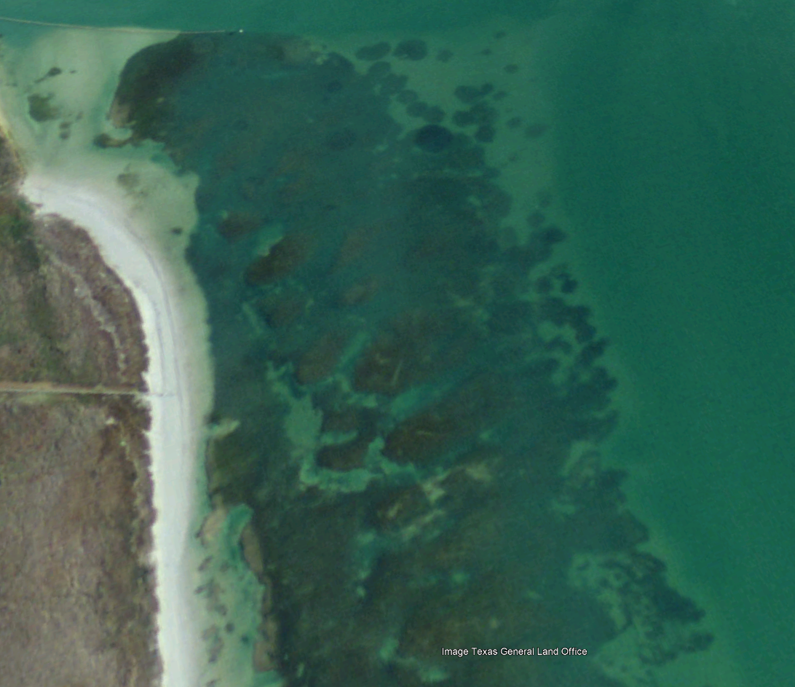
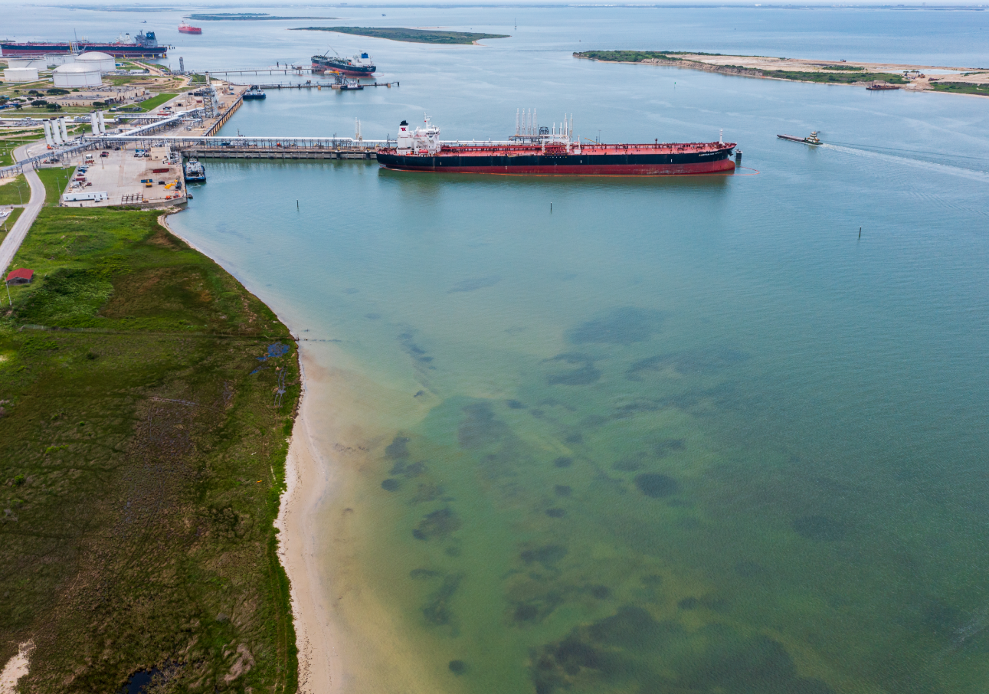
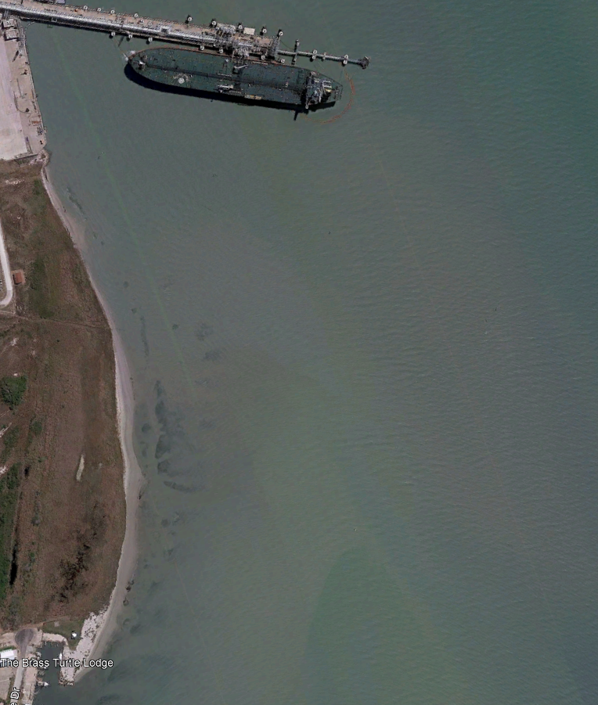
ENBRIDGE – LARGEST NORTH AMERICA OIL EXPORTER
Silt plume from dockING August 2020
enbridge
enbridge
Google GLO IMAGE 12/31/2008
enbridge
UPSTREAM DIVERSION
enbridge
WHAT EFFECT WILL INTAKE & DISCHARGE HAVE ON EVEN MORE SEAGRASS LOSS?
DRONE IMAGE 6/3/2021
Silt Plume from tugboats during docking operations. NOTE loss of seagrasses since 2008.
Google earth pro IMAGE 3/2022
Notes:
Silt Plume from tugboats during docking operations. NOTE loss of seagrasses since 2008.

Slide 12
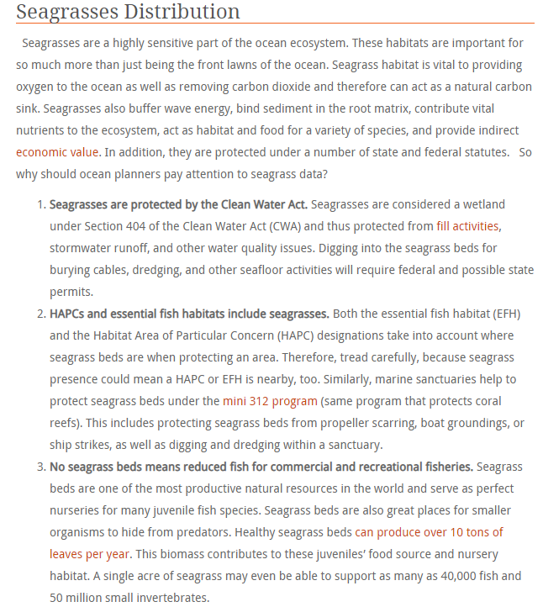
ARE SEAGRASSES PROTECTED?

Slide 13
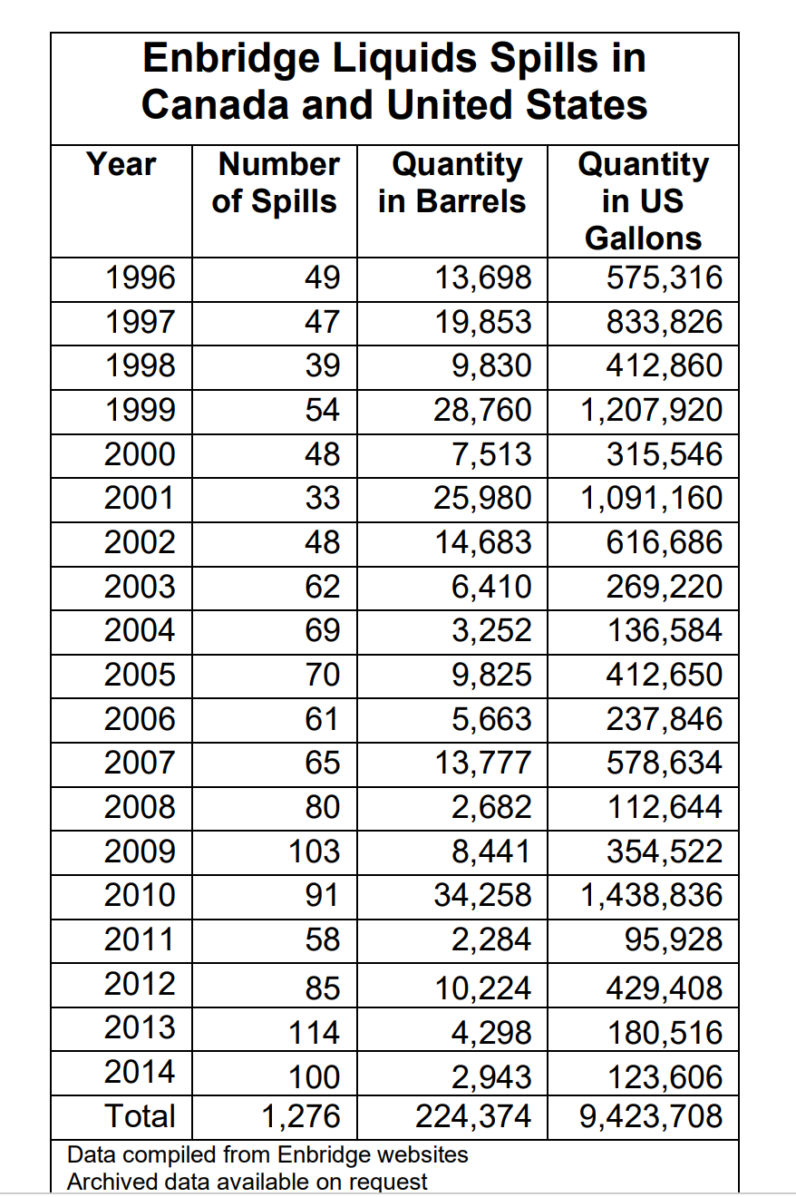
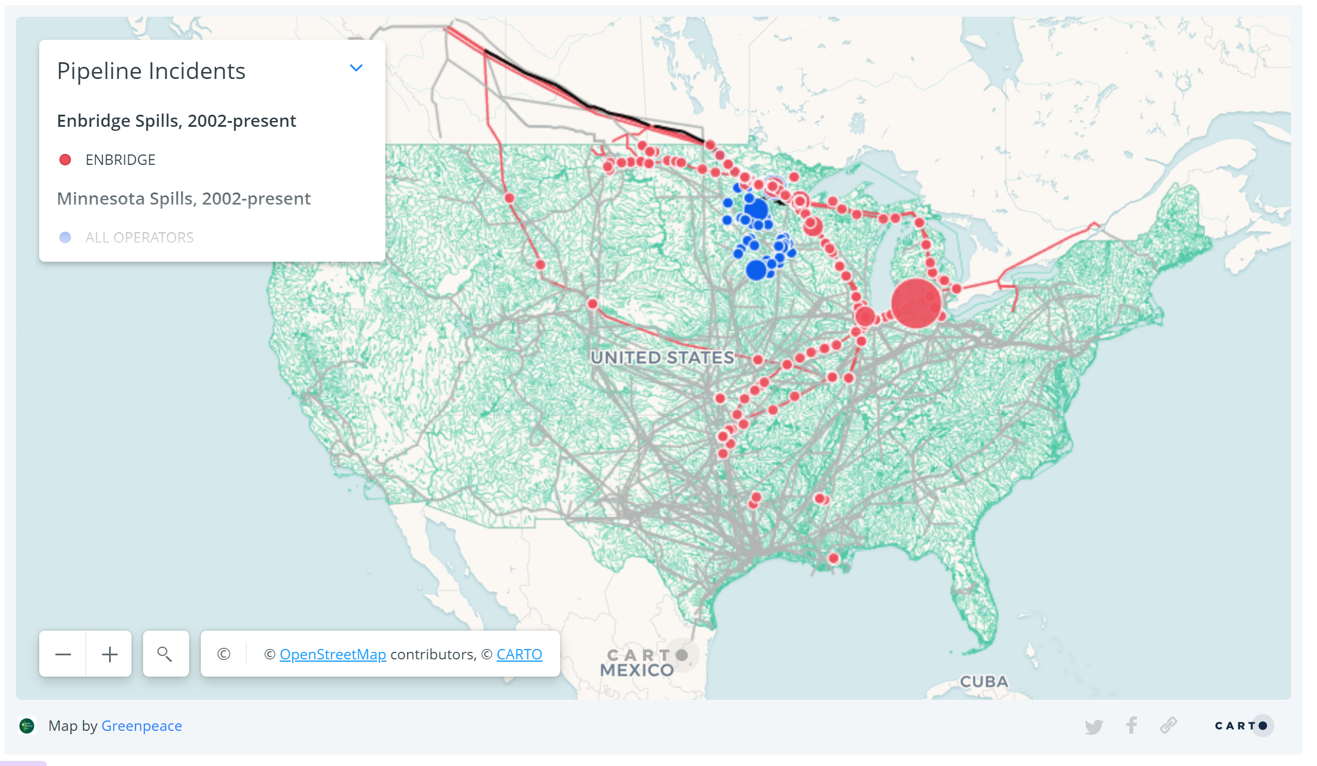
Enbridge Spill History 1996-Present
The Graph on right is Enbridge Spill History in the US and Canada from 1996 through 2014 of over 1000 spills and approaching 10 million gallons.
Map below depicts Enbridge Spills from 2002 to present.
Does this indicate high probability of a spill or worse??
Greenspace.org
February 2012 360.org/ Kishwaukee files

Slide 14
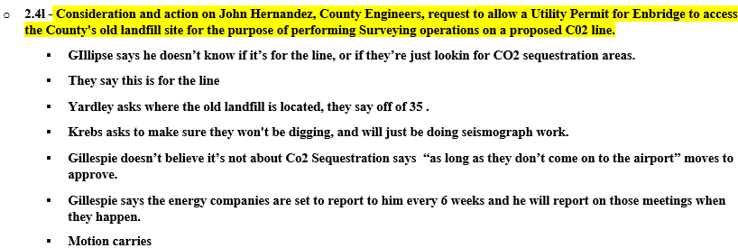
Co. Commissioners February 2024
ENBRIDGE APPROVAL FOR PIPELINE SURVEY
OUR NEIGHBOR ENBRIDGE
OUR NEIGHBOR YARA
INGLESIDE INDEX MAY 3, 2023
Goal – To Maintain our Quality of Life
Notes:
WHY ARE THEY PUTTING AMMONIA HERE
LAX REGULATIONS
THEY DON’T WANT IT IN CANADA
EUROPE DOESN’T WANT IT
WE ARE TOO SMALL TO OPPOSE THEM

Slide 15
TALKING POINTS
Water Rights (WR) are forever – WR can be transferred, sold & modified by applicant with TCEQ approval.
Permit states the Purpose is for industrial use “but not limited to” fire water & firewater pump testing.
Permit allows for “additional pump systems for future expansion”.
Enbridge/Yara have already initiated construction & are continuing to seek permits for pipelines.
Where is Enbridge’s emergency plan to justify the 476,371 gallons per day of bay water use?
Where does wastewater go during emergency use? Live oak trees, groundwater, CC Bay pollution & nearby communities are all at risk.
What is the intake velocity & expected aquatic mortality through impingement & entrainment?
Proximity of intake to seagrasses (~100’) increase aquatic mortality risks.
Upstream & Downstream flow direction are incorrect. Predominate tidal flow direction towards west & IOB.
Where will Enbridge/Yara get its water for producing 2.8million metric tons/year of ammonia?
TCEQ should perform an in-depth study to determine the risks for the huge volumes of bay water permitted for the intake & wastewater discharge.
Notes:
WHY ARE THEY PUTTING AMMONIA HERE
LAX REGULATIONS
THEY DON’T WANT IT IN CANADA
EUROPE DOESN’T WANT IT
WE ARE TOO SMALL TO OPPOSE THEM
THIS IS INSANITY
HURRICANE OF TOXIC EMISSIONS HEADING YOUR WAY

Slide 16
HERE’S WHAT YOU CAN DO!
City Ordinances: Should be reviewed to limit exposure
Prohibit CO2 pipelines
Prohibit ammonia plants
Impose noise limits
Impose light pollution limits
Require bonds for damages & victim compensation
No Carbon Capture - this is an unproved technology
Citizen Actions:
Submit comments on TCEQ WRPERM 13775
Attend the Public Meeting at 7PM at on February 29, 2024, at the North Shore Country Club, 801 East Broadway Ave, Portland, TX.
Submit eComments about Cheniere Trains 8 & 9 to FERC.gov re: FERC Docket CP23-129.
Visit IOBCWA.org for more information!
City Resolutions:
Deny tax abatements
TCEQ must install air monitors
Oppose new ammonia & fossil fuel expansion
Thank you
Our Goal – To Maintain our Quality of Life
Notes:
WHY ARE THEY PUTTING AMMONIA HERE
LAX REGULATIONS
THEY DON’T WANT IT IN CANADA
EUROPE DOESN’T WANT IT
WE ARE TOO SMALL TO OPPOSE THEM
THIS IS INSANITY
HURRICANE OF TOXIC EMISSIONS HEADING YOUR WAY

